Slide 1
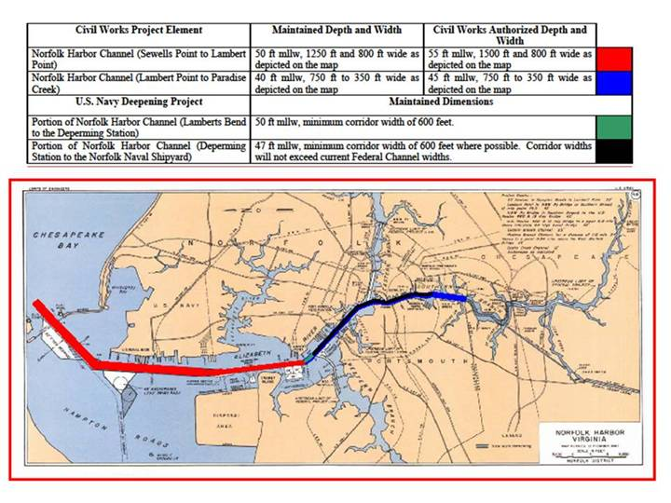
Elizabeth River Dredging
2011

